Slide 1


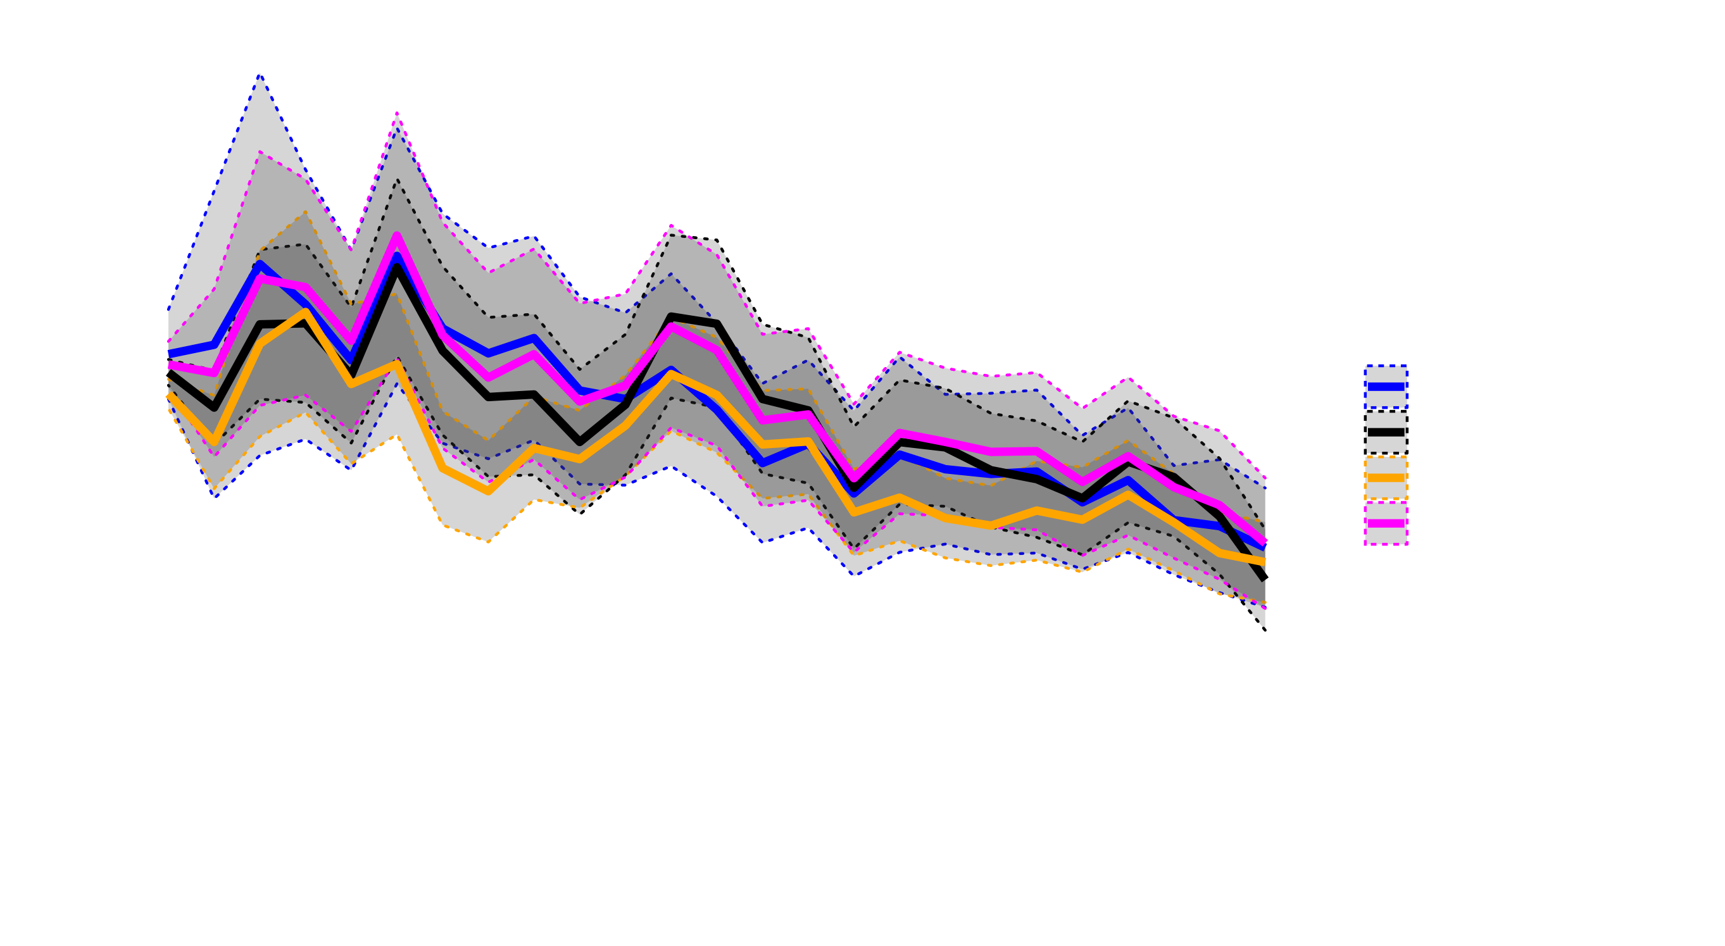
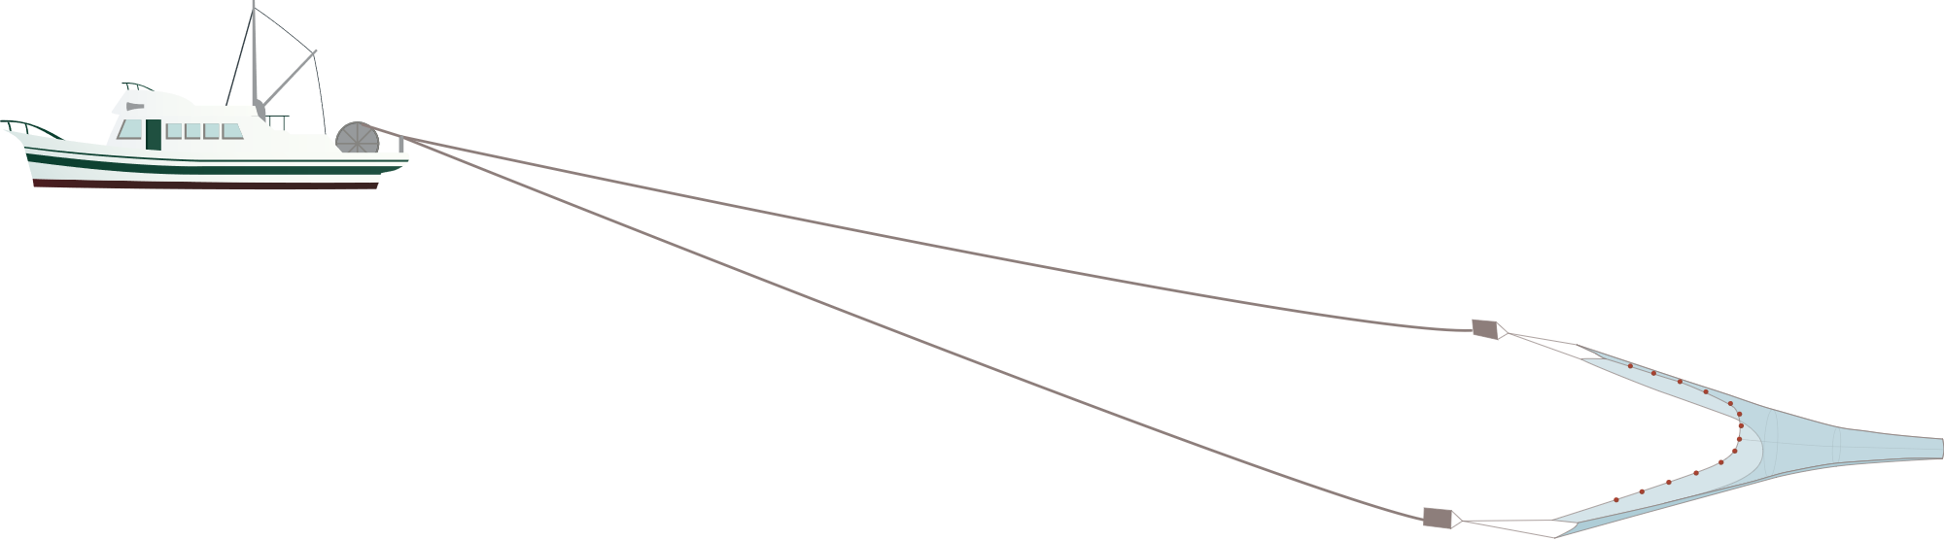
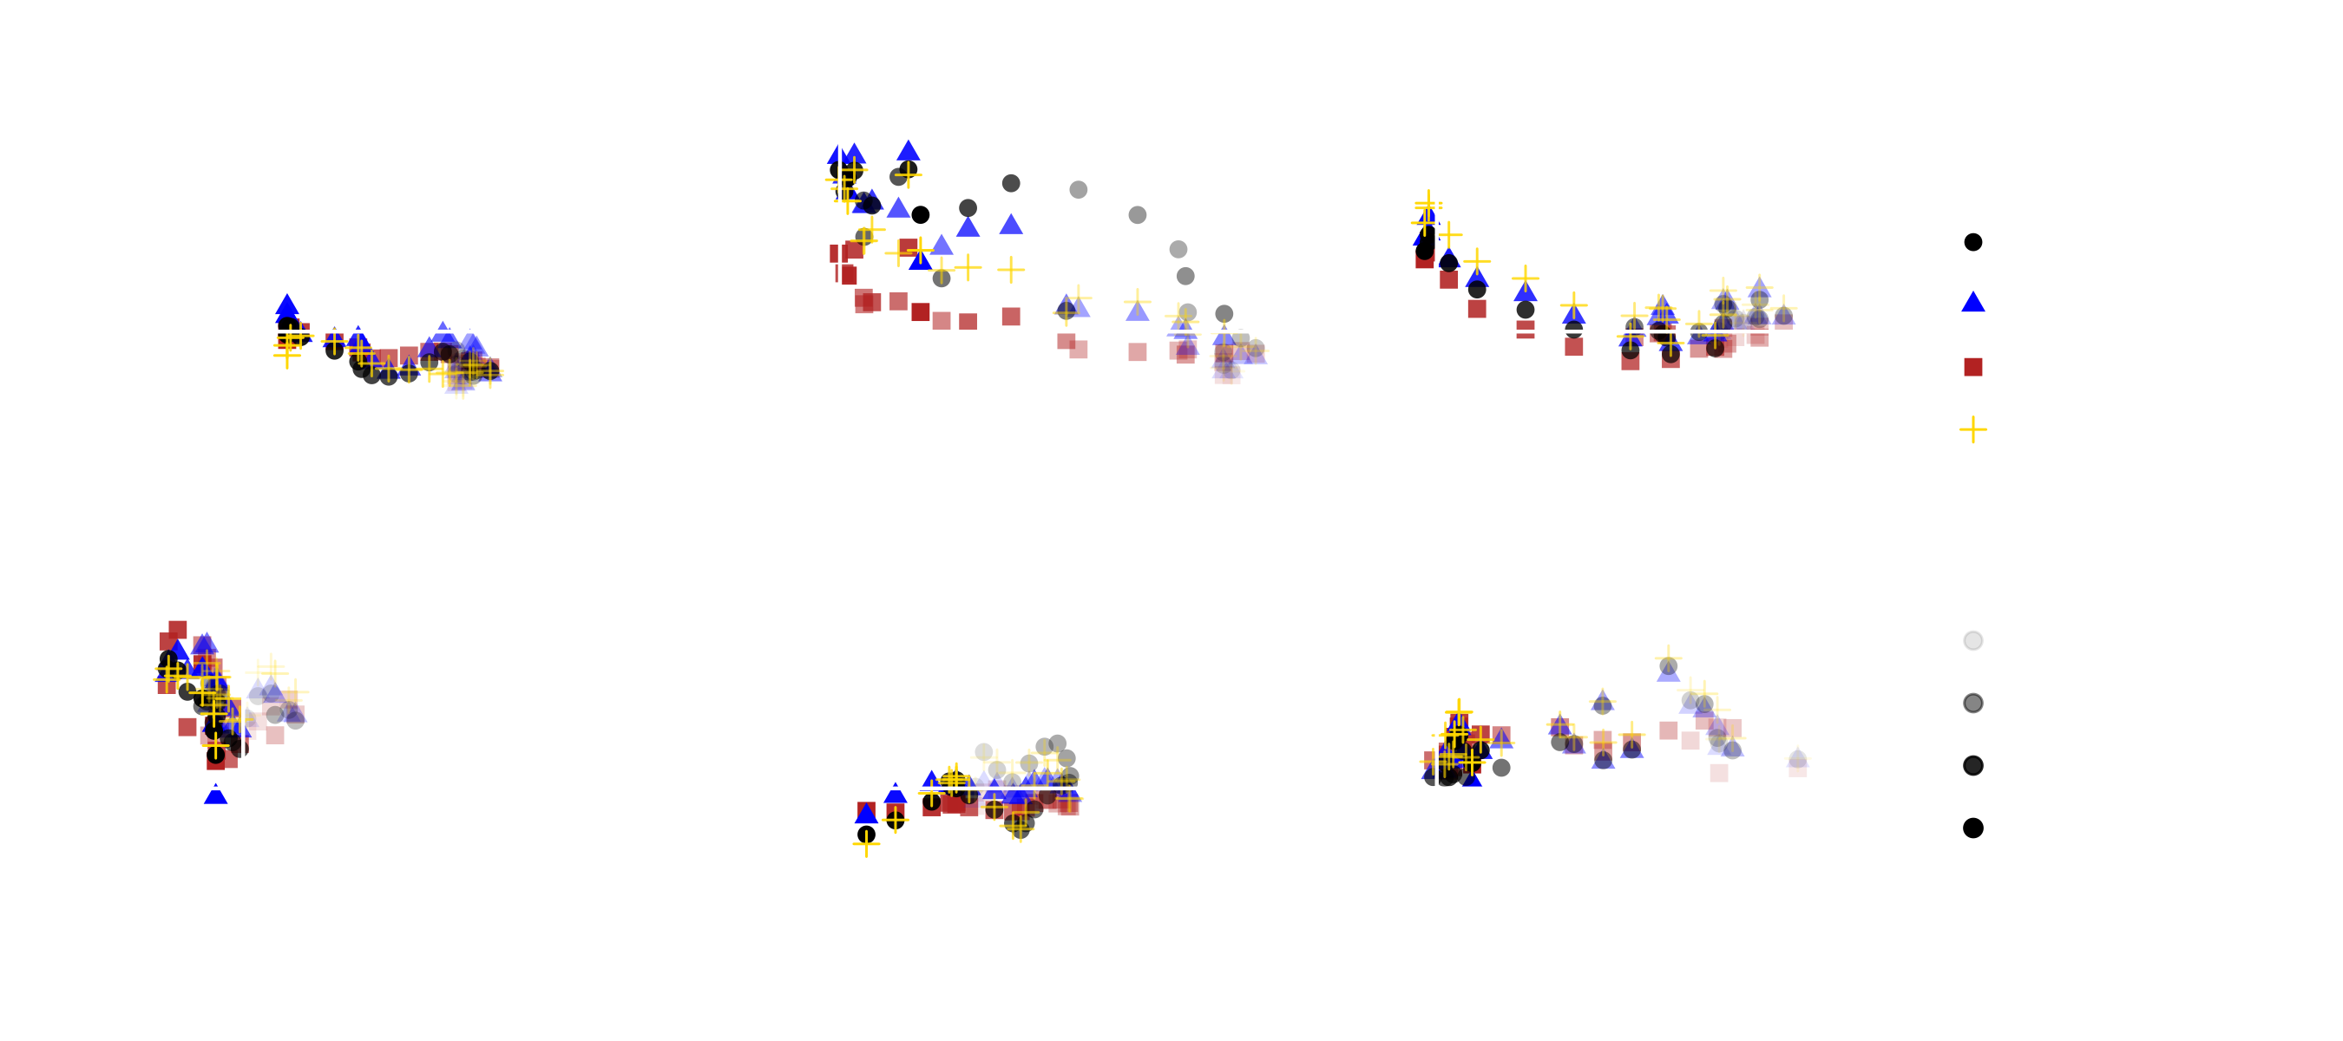
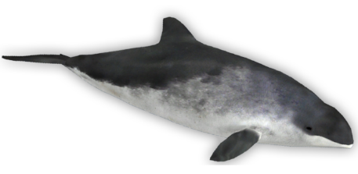



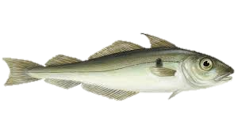
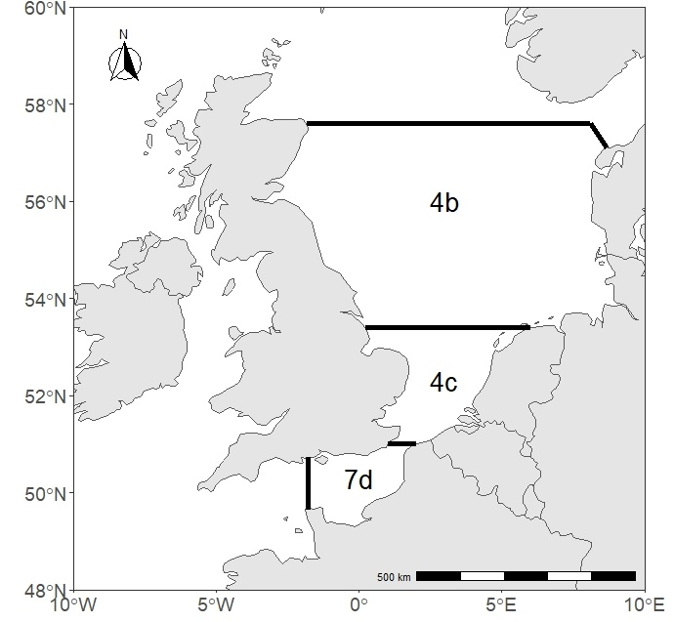

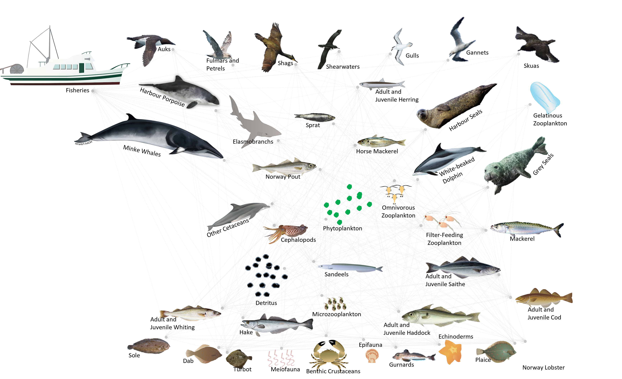
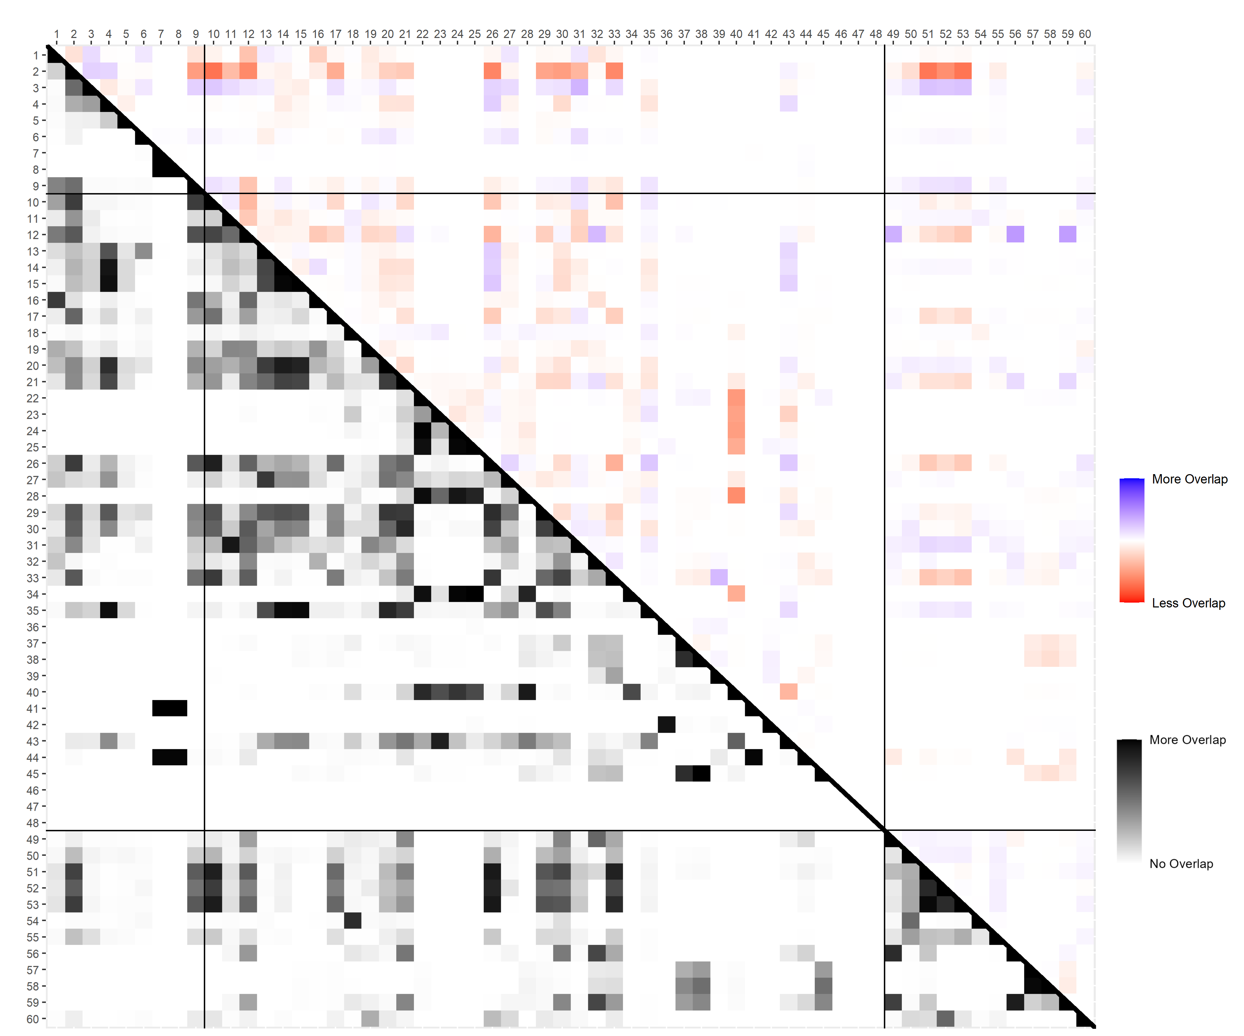




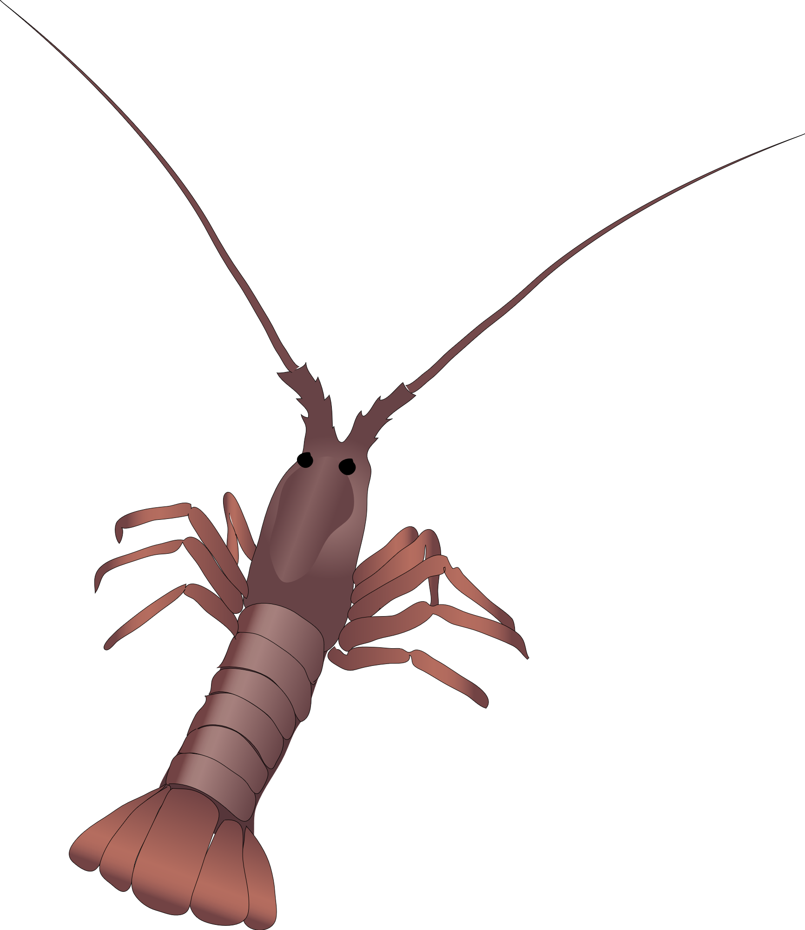
Debunking Misconceptions:
Abstract #: SMM2022277
Email: matthew.woodstock@morgan.edu
Marine mammals and seabirds have limited impacts on fisheries catches in the North Sea
Matthew S. Woodstock¹, Jeremy J. Kiszka¹, Peter G. H. Evans^{2,3}, James J. Waggitt³, Yuying Zhang¹
¹Florida International University, North Miami, FL, USA; ²Sea Watch Foundation, Isle of Anglesey, UK; ³Bangor University, Isle of Anglesey, UK
Rationale
Result 1: Total harvested biomass declined and was consistent among scenarios
Conclusions
Since 1990, the marine mammal abundance has markedly increased in the southern North Sea and the eastern English Channel, while seabird abundances declined in the 1990s and have been stable since the early 2000s.
Demersal fisheries has declined, but other fisheries have increased or maintained effort.
Changes to top predator biomass may influence commercial fish stocks, creating conflict with fishers, but this impact compared to the effect imposed by fisheries is enigmatic.
*Four scenarios were conducted to capture the uncertainty in top predator population trends and match inconsistencies with the SCANS aerial surveys
The cumulative fisheries harvest declined over time, which was largely driven by the decline in beam trawl fishing effort.
Commercially important fish stocks approached sustainable management goals.
As population size fluctuated throughout the simulation, so did the strength of predator-prey interactions.
Top predators and fisheries have limited resource overlap, caused by the wide diversity in predator diets.
Although the predation impact of marine mammal species increased with their increasing abundances, this increase was negligible relative to the annual fisheries harvest
Result 2: Most fisheries progressed towards current biomass and fishing morality targets
Objective
Evaluate the impact of changes to top predator abundances and fishing pressure on fisheries productivity
Top Predator
Fishery
Methods:
Develop an ecosystem model for the years 1990–2014 (Ecopath with Ecosim software)
Southern North Sea and eastern English Channel (ICES Regions 4b, 4c, and 7d)
Simulate trends in top predator abundance and commercial fishing effort and evaluate fisheries productivity and ecosystem functioning.
Potential Prey or Harvest Field
Implications
Result 3: Fisheries have a greater resource overlap with other fisheries than top predators (black) and only changed over time in a few interactions (red and blue)
The conflict between top predators and fisheries is not trivial, as increased marine mammal abundances may not necessarily lead to an additive increase in resource competition.
Due to the presence of mixed fisheries (target multiple species) in the region, fishers are likely competing with other commercial fishers more than marine mammals and seabirds.
Localized and seasonal effects may exist that are unaccounted for in this modeling effort.
Full Overlap
Top predators
Fisheries
Fisheries
60 Functional Groups
No Overlap
5 Marine Mammals
4 Seabirds
25 Fishes (5 age-structured)
11 Invertebrates
1 Primary Producer
2 Detritus
12 Fisheries
Increased Overlap
Top predators
Fisheries
Top predators
Decreased Overlap
*Each row and column is a different functional group in the model
This research was partially supported by an FIU Employer-Supported Provost Fellowship
Illustrations made publicly available by UMCES IAN (ian.umces.edu)
Notes:
But it is important to understand that humans are an integral part of ecosystems. According to a 2020 FAO fisheries report, 3.3 billion people worldwide rely on fishes and other seafood for greater than 20% of their animal protein intake. That is more than 40% of the global population. So, when we develop ecosystem-based models, we need to incorporate the effect of changes to fishing pressure and other anthropogenic effects. In the North Sea, since the early 2000s, the total effort of demersal gears, such as bottom trawls, has decreased in response to fishing regulations while the effort of pelagic gears has increased slightly. However, demersal fishing gears are still the dominant fisheries in the region.
/next/
Conflict arises when top predators, which typically consume commercial species as a portion of their diet, move into lucrative fishing grounds. The competition between marine mammals and seabirds with fisheries is a global problem that is present wherever the two parties are present, and in some places persuaded some to call for population control measures, such as culling. It is therefore critical to quantify the consumptive effects of both top predators and fisheries on commercial fish populations, and their competitive interactions resulting competition, should be quantified to better understand the indirect impact of population trends on fisheries (and vice versa).

